Slide 1
DLL-Operations
Dr.Gireesh Kumar T

Slide 2
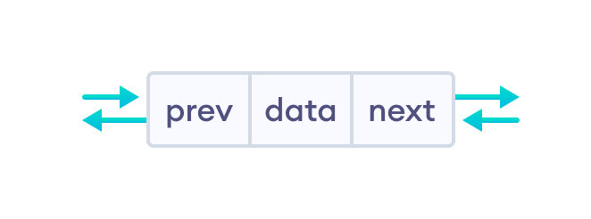
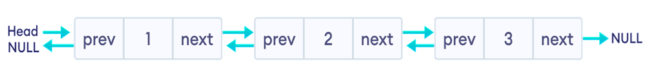
*prev - address of the previous node
data - data item
*next - address of next node

Slide 3
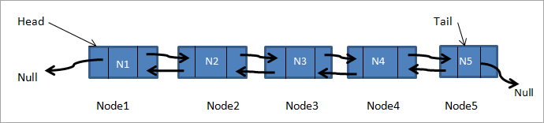
A doubly linked list node
struct Node {
int data;
struct Node* next;
struct Node* prev;
};

Slide 4
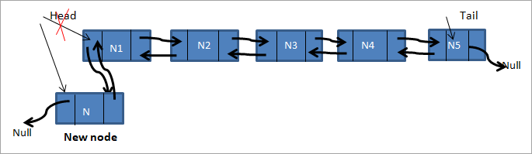
Insert-front

Slide 5
//inserts node at the front of the list
void insert_front(struct Node** head, int new_data)
{
//allocate memory for New node
struct Node* newNode = new Node;
//assign data to new node
newNode->data = new_data;
//new node is head and previous is null, since we are adding at the front
newNode->next = (*head);
newNode->prev = NULL;

Slide 6
//previous of head is new node
if ((*head) != NULL)
(*head)->prev = newNode;
//head points to new node
(*head) = newNode;
}

Slide 7
insert a new node after the given node
void insert_After(struct Node* prev_node, int new_data)
{
//check if prev node is null
if (prev_node == NULL) {
cout<<"Previous node is required , it cannot be NULL";
return;
}
//allocate memory for new node
struct Node* newNode = new Node;
//assign data to new node
newNode->data = new_data;

Slide 8
//set next of newnode to next of prev node
newNode->next = prev_node->next;
//set next of prev node to newnode
prev_node->next = newNode;
//now set prev of newnode to prev node
newNode->prev = prev_node;
//set prev of new node's next to newnode
if (newNode->next != NULL)
newNode->next->prev = newNode;
}

Slide 9
new node at the end of the list
void insert_end(struct Node** head, int new_data)
{
//allocate memory for node
struct Node* newNode = new Node;
struct Node* last = *head; //set last node value to head
//set data for new node
newNode->data = new_data;

Slide 10
//new node is the last node , so set next of new node to null
newNode->next = NULL;
//check if list is empty, if yes make new node the head of list
if (*head == NULL) {
newNode->prev = NULL;
*head = newNode;
return;
}

Slide 11
traverse the list to go to last node
while (last->next != NULL)
last = last->next;
//set next of last to new node
last->next = newNode;
//set last to prev of new node
newNode->prev = last;
return;
}

Slide 12
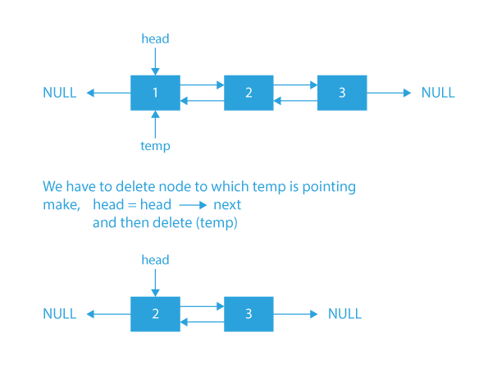
Case1: If the node to be deleted is the head node.

Slide 13
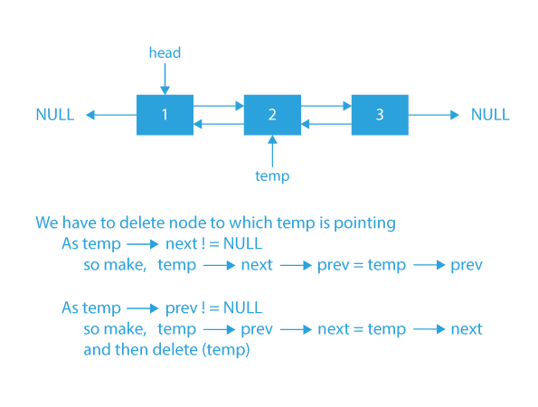
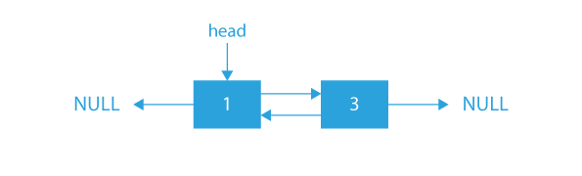
somewhere in the middle of the linked list.

Slide 14
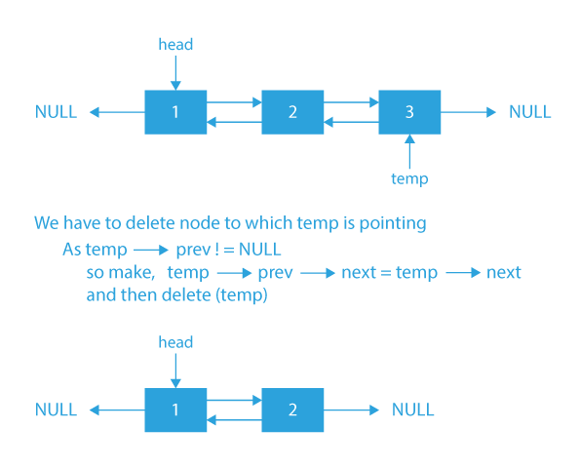
deleted is the tail of the linked list.

Slide 15
Algorithm
If the node temp which we want to delete is NULL or the head is NULL, we will simply return.
Then we will check if temp is a head node or not.
If temp is the head node, then we will move head to head→next.
If the prev of temp is not NULL, we will change the prev of the next of temp to the prev of temp.
If the next of temp is not NULL, we will change the next of the prev of temp to the next of temp.
Finally, we will free the space allocated to the temp.
After all the above steps, the node temp will be deleted from the Doubly Linked List.

Slide 16
void deleteNodefromList(DLLNode** head, DLLNode* temp)
{
if (*head == NULL || temp == NULL)
return;
if (*head == temp)
*head = temp->next;
if (temp->next != NULL)
temp->next->prev = temp->prev;
if (temp->prev != NULL)
temp->prev->next = temp->next;
free(temp);
return;
}

Slide 17
https://www.softwaretestinghelp.com/doubly-linked-list-2/
https://www.softwaretestinghelp.com/stack-in-cpp/
https://www.simplilearn.com/tutorials/data-structure-tutorial/queue-implementation-using-array

